Slide 1


OPTIMIZING INVENTORY MANAGEMENT USING 2020 IOWA LIQUOR SALES DATA
Trisha Winquist
12/16/2024
Bellevue University

Slide 2
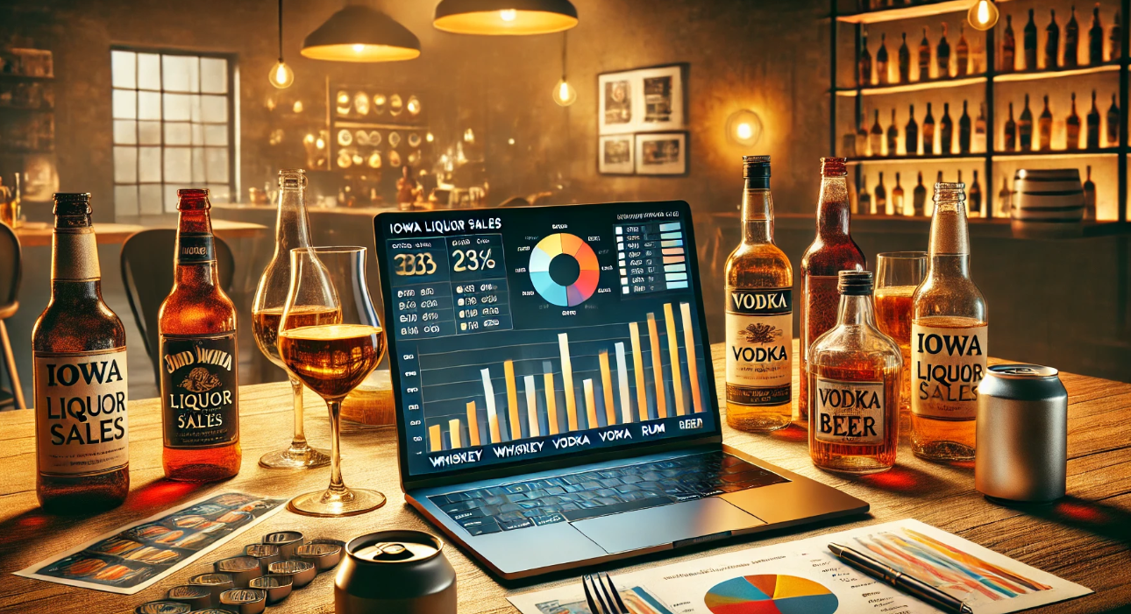
IMPORTANCE OF INVENTORY MANAGEMENT IN THE LIQUOR INDUSTRY
Using 2020 Iowa Liquor Data
Effective inventory management is crucial for maintaining profitability. Liquor retailers must balance the need to stock popular products without overstocking slow-moving items. This can help reduce both excess inventory and stockouts, leading to improved sales and customer satisfaction.

Slide 3
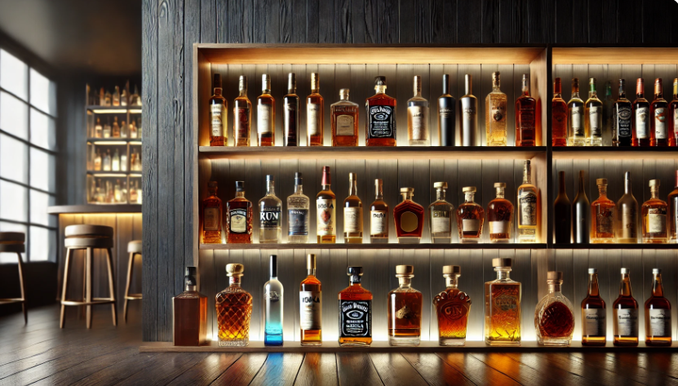
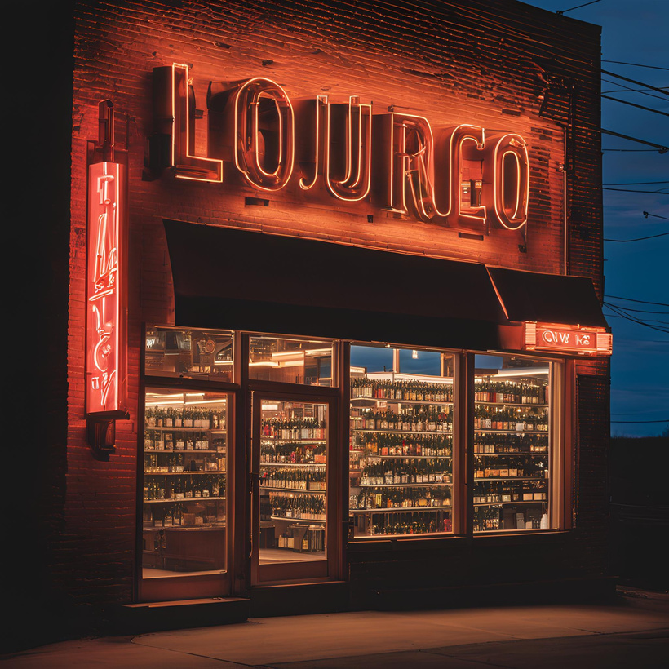
USING DATA ANALYTICS TO PREDICT LIQUOR SALES IN IOWA
In 2020, the total liquor sales in Iowa amounted to $362,277,699.62. This figure reflects the total revenue generated from the sale of alcoholic beverages across the state, including spirits, and other liquor products. The significant scale of these sales highlights the steady demand for alcoholic beverages in Iowa, suggesting a strong consumer market and a robust retail environment within the state.

Slide 4
THE DATA ANALYSIS PROCESS
Data Collection
Data is collected from a publicly available web browser from data.gov. This data contains the spirits purchase information of Iowa Class “E” liquor lisences by product and date of purchase from January 1 2020 to Dec 31 2022
The dataset can be used to analyze total spirits sales in Iowa of individual products at the store level.
Content: This dataset contains information on the name, kind, price, quantity, and location of sale of sales of individual containers or packages of containers of alcoholic beverages.
Cleaning
Data Cleaning: Handle missing values, remove duplicates, and ensure all dates are in a consistent format.
Feature Engineering: Extract useful features such as the day of the week, month, or season from the sale date. You could also create features based on weather or holidays if using supplementary data.
Interpretation, and Reporting
Data Analysis
Exploratory Data Analysis (EDA)
Time Series Analysis:
Machine Learning Models
Classification
This dataset contains transaction-level information about liquor sales in Iowa. It includes columns such as product name, sale date, quantity sold, price, store ID, and more.

Slide 5
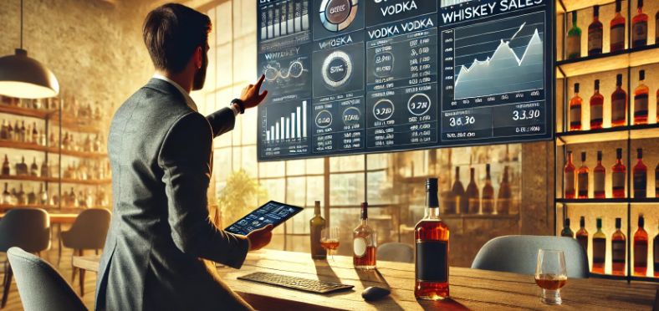
TOP QUESTIONS REGARDING THE IOWA LIQUOR DATA
Leveraging Technology for Better Insights
Which types of liquor experienced the highest increase in sales during 2020?
How did the COVID-19 pandemic influence liquor consumption in Iowa?
What counties in Iowa had the highest liquor sales in 2020?
Were there any notable patterns in the times or seasons when liquor sales peaked in 2020?
In 2020, did grocery stores in Iowa sell more liquor than standalone liquor stores?
How can businesses use Iowa liquor sales data and advanced inventory optimization technologies to improve operational efficiency, reduce costs, and maximize profitability?

Slide 6
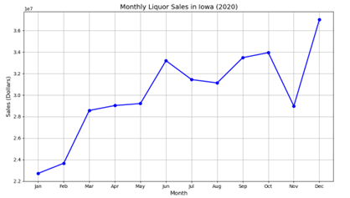
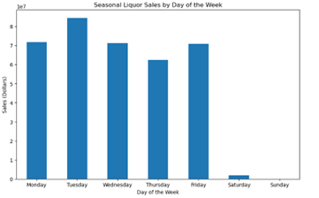
INVENTORY MANAGEMENT
Sales by Month and day of the week- to help make data-driven decisions about stock Levels, staffing and promotions
Making Data Understandable
Monday through Friday were steady while the weekend sales were lower This suggests that the demand for liquor is largely driven by weekday purchases.
Summer Months were steady as the growth progressed through the year

Slide 7
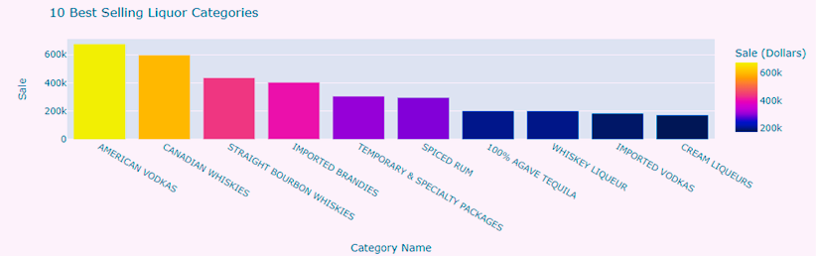
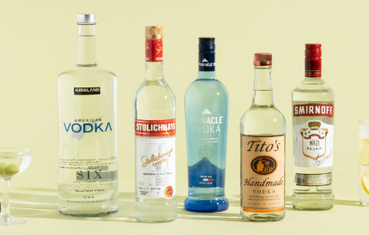
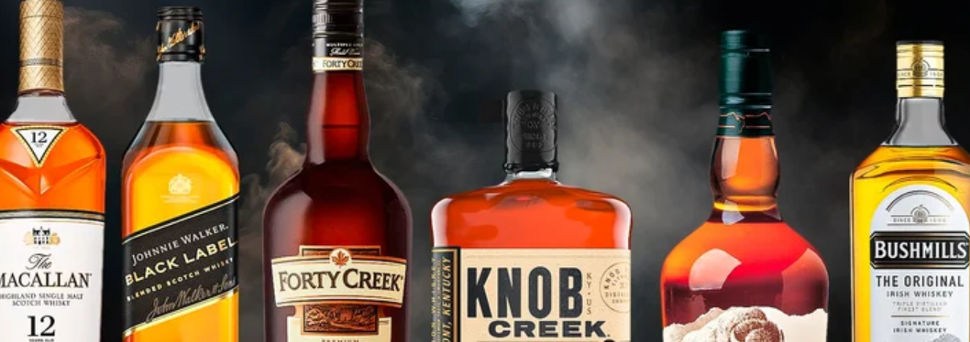
10 Best Selling Liquor Categories
Whiskey and Vodka continue to dominate the market

Slide 8
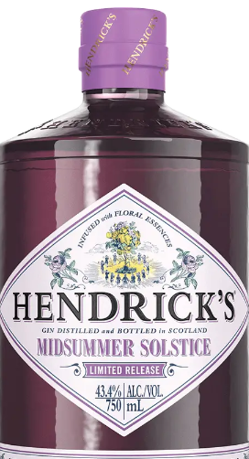
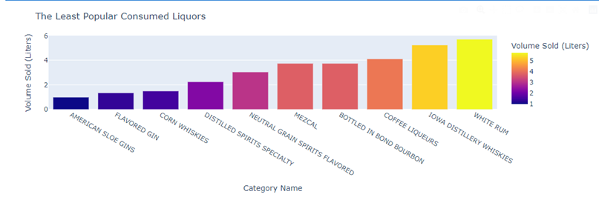
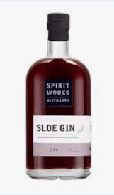
Targeted Marketing: For products like Mezcal or Flavored Gins, focused marketing efforts can help raise awareness and educate consumers on their unique qualities.
· Expand Distribution: Categories like Iowa Distillery Whiskies could benefit from increased distribution or partnerships with local retailers to promote regional pride and craft spirits.
· Promotions and Seasonal Campaigns: Products with seasonal appeal, such as Coffee Liquors or White Rum, could benefit from promotional campaigns timed with specific holidays or events.
The Least popular Consumed Liquors

Slide 9
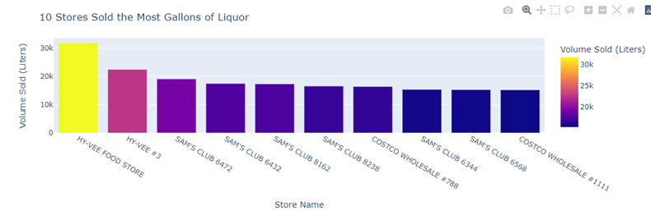
Top 10 Stores that sold the most
These stores played a significant role in the retail liquor market and collectively contributed to a large portion of the overall sales volume. The specific stores of interest include Hy-Vee, Sam's Club, and Costco, which are well-known for their extensive retail operations and wide product selection.
By analyzing the Top 10 Stores by Gallons Sold, stock managers can make more informed decisions about inventory allocation, demand forecasting, product selection, and distribution strategies. The goal is to ensure that high-performing stores are always well-stocked with the right products, while also making adjustments for seasonal demand and consumer preferences. The insights from these stores also provide opportunities to enhance promotional campaigns and ensure timely replenishment, thus improving overall sales and customer satisfaction.
By adopting these strategies, stock management can become more efficient, reduce waste from overstocking, and ultimately boost profitability.

Slide 10
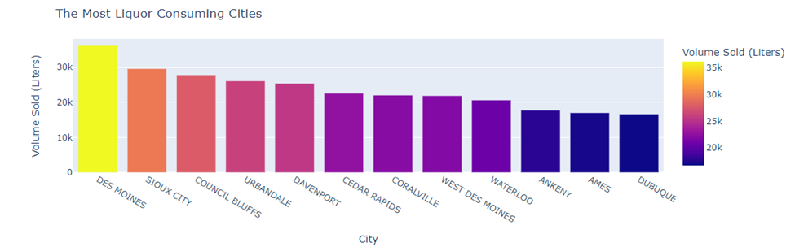
The most Consuming Cities
Understanding which cities are consuming the most liquor in Iowa allows for more precise stock management, helping to ensure that inventory is properly allocated to match demand in each region. By focusing efforts on cities with the highest consumption, liquor sales can be optimized, while also improving customer satisfaction through timely and targeted stock replenishment. This data-driven approach can also guide promotional campaigns, logistical planning, and future sales forecasting

Slide 11
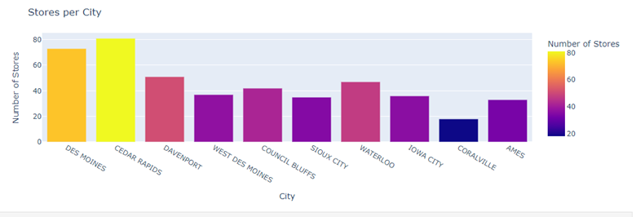
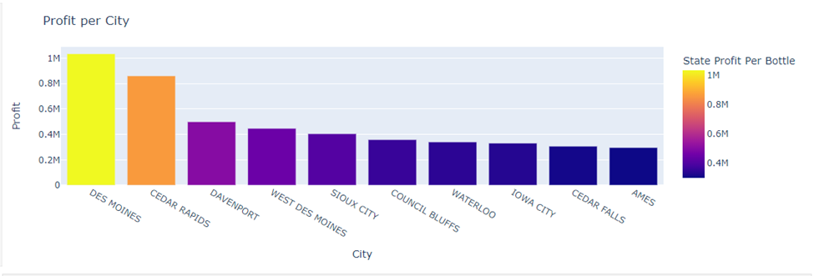
Stores Per City
This analysis is useful for understanding where to focus efforts for inventory allocation, stock replenishment, and promotional strategies
Profit Per City
Calculating and understanding profit per city can be a powerful tool for improving stock management, marketing strategies, and overall business performance. By focusing efforts on the most profitable cities, you can ensure that resources are allocated efficiently to drive growth in key regions.

Slide 12

CHALLENGES IN DATA INVENTORY MANAGMENT
Overcoming Common Obstacles
One of the major challenges is ensuring that the data used for analysis is of high quality and accurate. Inconsistent, incomplete, or erroneous data can lead to incorrect demand forecasts, inventory recommendations, and pricing strategies.
·Example: If sales data for certain cities, like Des Moines or Council Bluffs, is inaccurate or missing, the system may miscalculate demand trends, leading to stockouts or overstocking in certain locations.
Many businesses may already be using legacy inventory management systems, which may not easily integrate with newer technologies like advanced data analytics or AI-based forecasting tools. Integrating different systems can be complex, time-consuming, and costly.
Example: A liquor retailer in Cedar Rapids may already be using an older point-of-sale (POS) system that doesn’t integrate seamlessly with modern data analytics platforms, leading to delays in obtaining real-time sales data.

Slide 13

CONCLUSION
The Future of Data Analysis
Leveraging technology for inventory optimization in Iowa’s liquor industry offers immense potential for improving efficiency, maximizing profitability, and better serving customers. Through advanced analytics, real-time tracking, and predictive tools, businesses can more accurately forecast demand, streamline their supply chain, and ensure that stores are stocked with the right products at the right time. The data collected from Iowa’s liquor sales, including sales by day of the week, seasonal trends, and city-specific patterns, provides valuable insights that can drive smarter inventory management decisions.

Slide 14
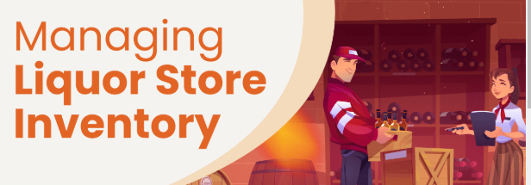
THANK YOU
2024 Data Analysis Presentation

